Slide 1
Week 4
Alexey V. Zimin
JHU BME 580.417/707

Slide 2
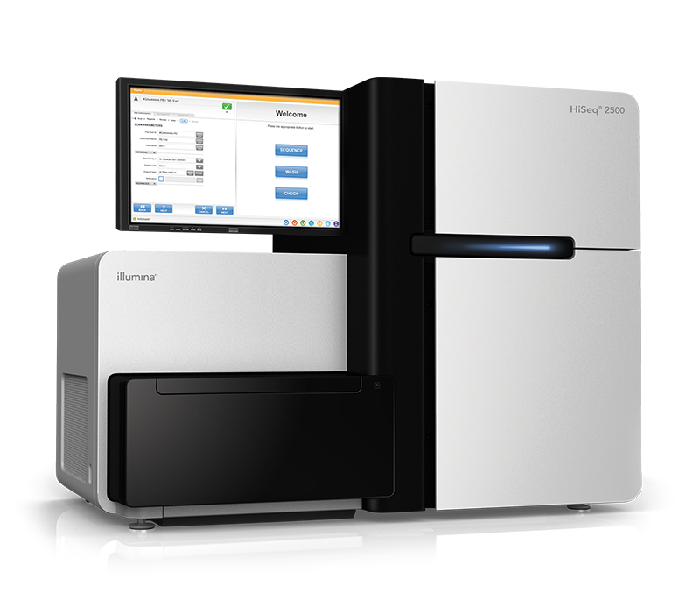
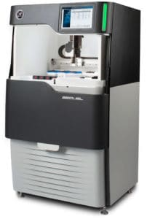
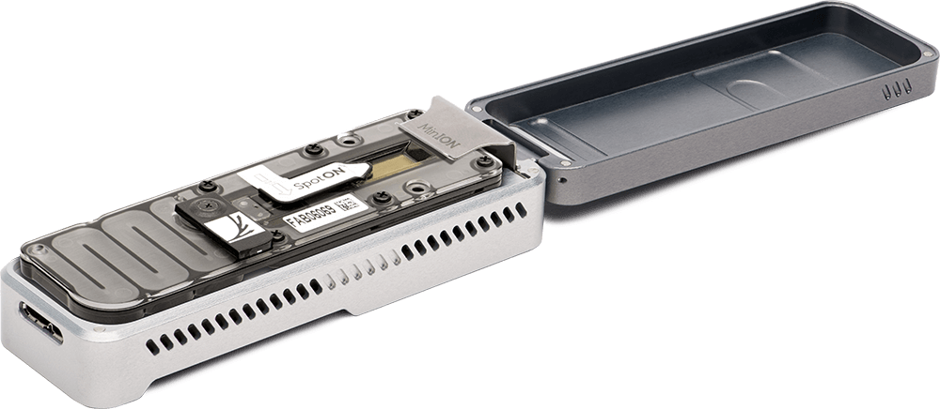
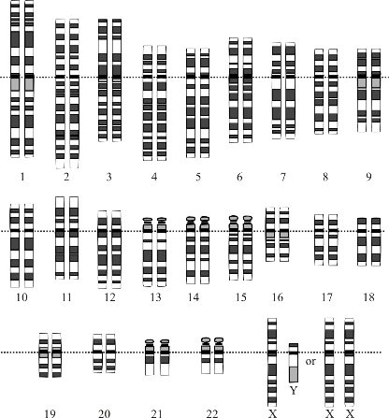
Overview
Multiple copies of DNA
Fragments of
150 - >500,000 bases
Read the Sequences
Shred &
(Size select)
Scaffolding
Pairs of Reads of ~150-250 bp each
Contig assembly
CAAGCTGAT...
…GTTTGGAAC
OR Long reads 10+ kb each
Image Courtesy: National Human Genome Research Institute

Slide 3
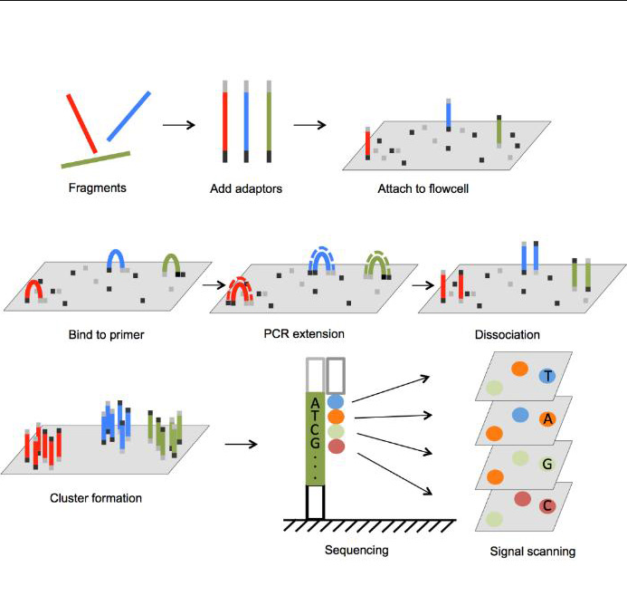
Sequencing technologes: Illumina
Overview of Illumina Sequencing by Synthesis Workflow | Standard SBS chemistry
Souurces: https://www.bmkgene.com/dnarna-sequencing-illumina-sequencer-product/, Illumina

Slide 4
Sequencing technologes: Illumina
Overview of Illumina Sequencing by Synthesis Workflow | Standard SBS chemistry
Potential problems with Illumina data:
Incomplete incorporation, leads to “de-synchronization” of spots, quality decreases along the read
Reverse read spots are bigger -- lower intensity, higher error rate
Errors:
Sequencing is discrete process most of the errors are substitutions, indels are rare (1/100)
Typical error rate of 1%
High coverage: two or more reads can have the same error at the same base
Souurces: https://www.bmkgene.com/dnarna-sequencing-illumina-sequencer-product/, Illumina

Slide 5
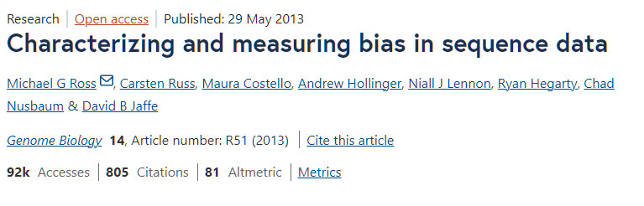
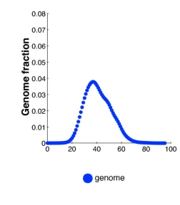
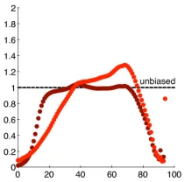

Sequencing: GC bias
Illumina: there are biases due to flexibility of strands (GC bias)

Slide 6
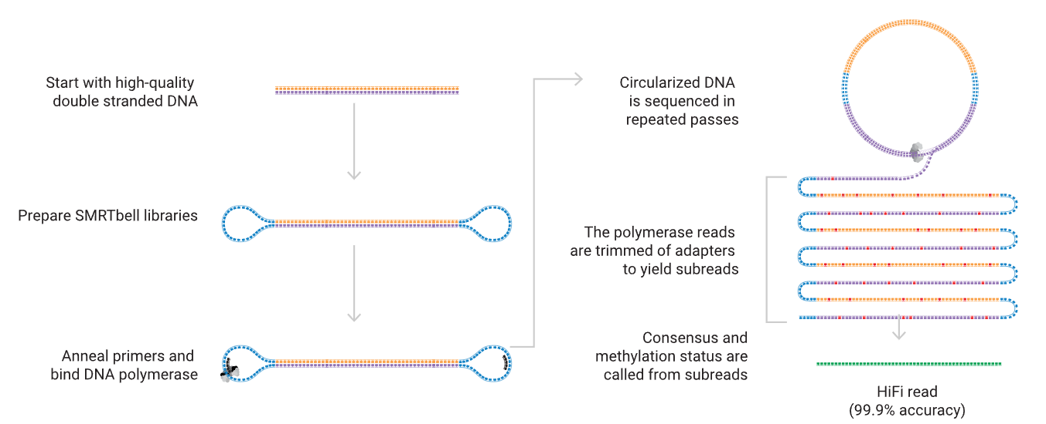
Sequencing technologies: PacBio CLR/HiFi
Sequencing 101: from DNA to discovery — the steps of SMRT sequencing - PacBio
Source: PacBio

Slide 7
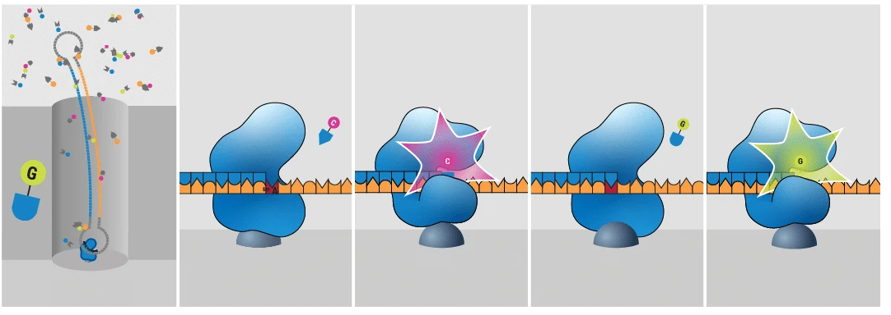
Sequencing technologies: PacBio CLR/HiFi
Sequencing 101: from DNA to discovery — the steps of SMRT sequencing - PacBio
Source: PacBio

Slide 8
Sequencing technologies: PacBio CLR/HiFi
Sequencing 101: from DNA to discovery — the steps of SMRT sequencing - PacBio
Source: PacBio

Slide 9
Sequencing technologies: PacBio CLR/HiFi
Potential problems with PacBio data:
CLR reads are longer but have ~15% error rate
Most errors are insertions (~10% of the 15%)
Polymerase pauses -- insertions of random sequence
Chimeric “palindrome” reads -- no SMRTbell adapter
Errors:
Most errors in CLR are insertions (~10% of the 15%)
HiFi reads have variable (~1%) error rate, longer reads=higher error rate
Some reads have higher error rate
Sequencing 101: from DNA to discovery — the steps of SMRT sequencing - PacBio
Source: PacBio

Slide 10
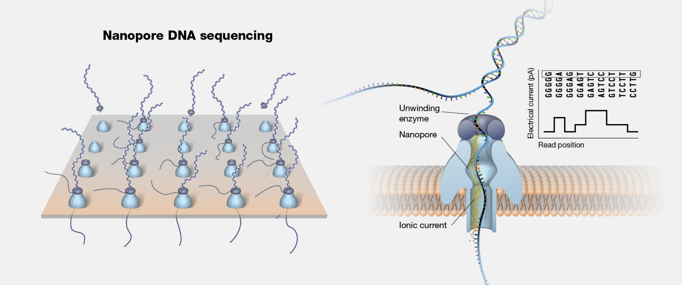
Sequencing technologies: Oxford Nanopore
How nanopore sequencing works | Oxford Nanopore Technologies
Source:genome.gov

Slide 11
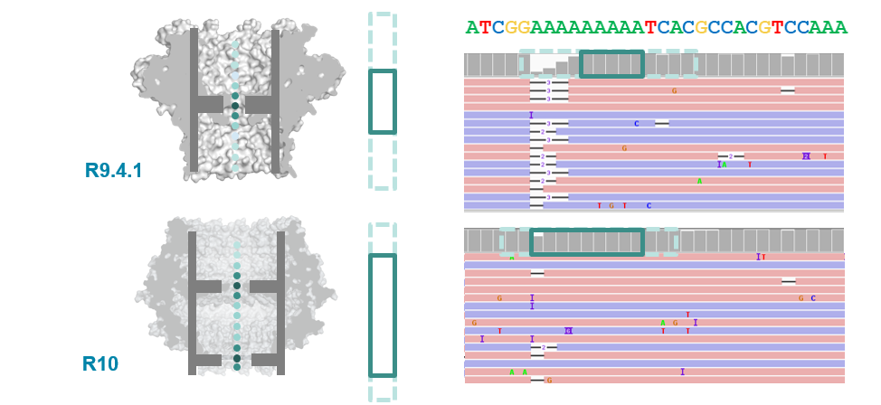
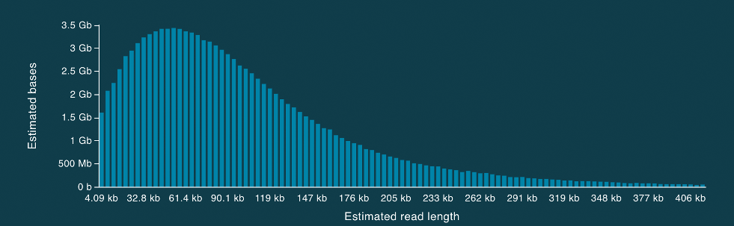
Sequencing technologies: Oxford Nanopore
Oxford Nanopore:
higher error rates (5-7%), lower for R10 (2 currents)
Unable to estimate speed -- errors in homopolymers (AAAAAAA), SSRs (ATATATA)
difficulties with getting long reads, some species (crustaceans/coffee) are hard to sequence (low yield)
chimeric reads due to fragments of DNA sticking together

Slide 12
Dealing with errors in the reads
You can compensate for some of the errors
Create a dictionary of all (K-mer -> count) pairs in all reads
K-mer counts
At 100x genome coverage most (but not all) K-mers of count 1 contain errors
Can correct of filter out reads with locally low K-mer counts

Slide 13
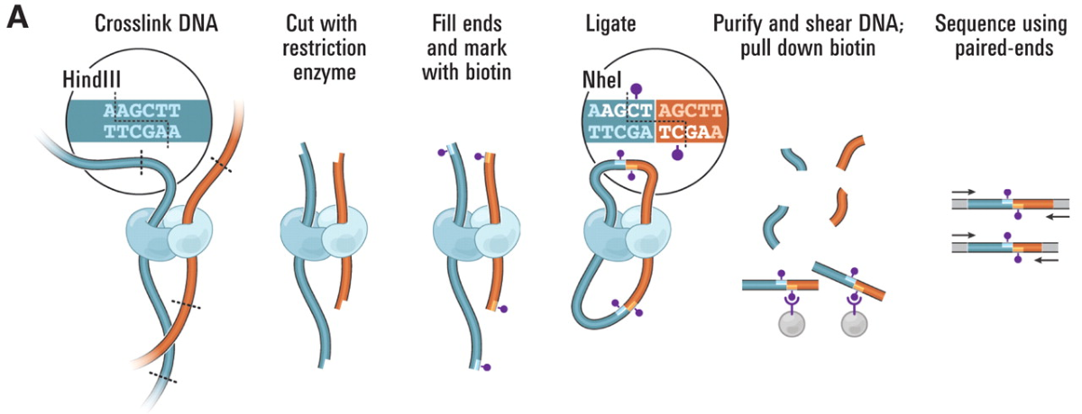
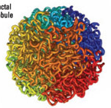
Types of sequencing reads
Proximity ligation or Hi-C libraries
Sequenced with paired-end Illumina
Formaldehyde
(creates covalent
bonds)
Images from: Van Berkum NL, Lieberman-Aiden E, Williams L, Imakaev M, Gnirke A, Mirny LA, Dekker J, Lander ES. Hi-C: a method to study the three-dimensional architecture of genomes. Journal of visualized experiments: JoVE. 2010(39).

Slide 14
Types of sequencing reads
Proximity ligation or Hi-C libraries
Sequenced with paired-end Illumina
Images from: Van Berkum NL, Lieberman-Aiden E, Williams L, Imakaev M, Gnirke A, Mirny LA, Dekker J, Lander ES. Hi-C: a method to study the three-dimensional architecture of genomes. Journal of visualized experiments: JoVE. 2010(39).

Slide 15
Types of sequencing reads
Proximity ligation or Hi-C libraries
Sequenced with paired-end Illumina
Images from: Van Berkum NL, Lieberman-Aiden E, Williams L, Imakaev M, Gnirke A, Mirny LA, Dekker J, Lander ES. Hi-C: a method to study the three-dimensional architecture of genomes. Journal of visualized experiments: JoVE. 2010(39).

Slide 16
Types of sequencing reads
Proximity ligation or Hi-C libraries
Sequenced with paired-end Illumina
Images from: Van Berkum NL, Lieberman-Aiden E, Williams L, Imakaev M, Gnirke A, Mirny LA, Dekker J, Lander ES. Hi-C: a method to study the three-dimensional architecture of genomes. Journal of visualized experiments: JoVE. 2010(39).

Slide 17
Types of sequencing reads
Proximity ligation or Hi-C libraries
Sequenced with paired-end Illumina
Images from: Van Berkum NL, Lieberman-Aiden E, Williams L, Imakaev M, Gnirke A, Mirny LA, Dekker J, Lander ES. Hi-C: a method to study the three-dimensional architecture of genomes. Journal of visualized experiments: JoVE. 2010(39).

Slide 18
Types of sequencing reads
Proximity ligation or Hi-C libraries (variants: Omni-C, Chicago)
Sequenced with paired-end Illumina
Images from: Van Berkum NL, Lieberman-Aiden E, Williams L, Imakaev M, Gnirke A, Mirny LA, Dekker J, Lander ES. Hi-C: a method to study the three-dimensional architecture of genomes. Journal of visualized experiments: JoVE. 2010(39).

Slide 19
What kind of data do you get?
Pairs or reads: random orientations, unknown distances

Slide 20
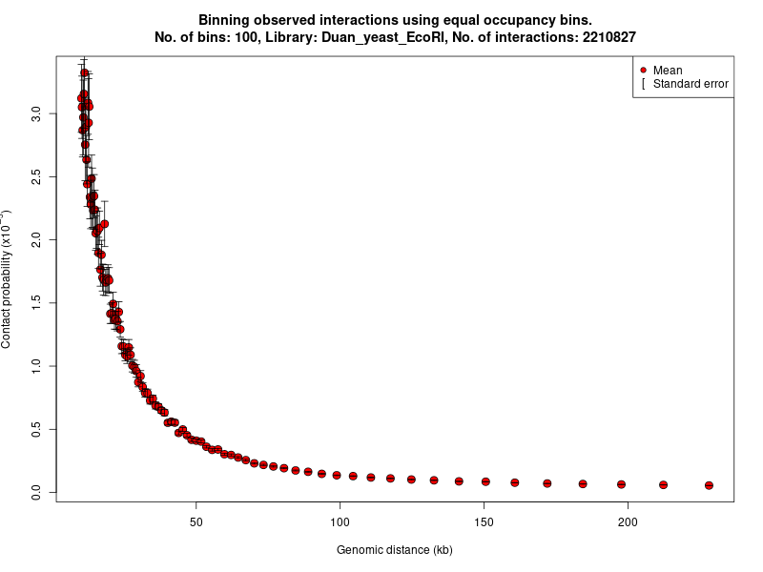
Hi-C scaffolding: why it works?
Contig 1
Contig 2
Many contacts (links) == nearby
Few contacts (links) == far away
Image from: https://www.bioconductor.org/packages/release/bioc/vignettes/FitHiC/inst/doc/fithic.html

Slide 21
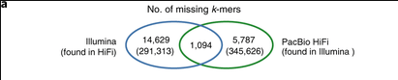
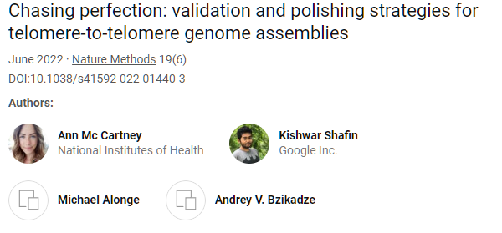
Sequencing: what could go wrong
PacBio vs Illumina
Human assembly vs K-mers in Illumina and PacBio HiFi reads

Slide 22
Repeat regions cause mistakes
A
R
B
R
C
A
R
C

Slide 23
Long reads help avoid mistakes
A
R
B
R
C

Slide 24
Choosing the right sequencing strategy
The right sequencing strategy depends on your budget and availability of sequencing services
The simplest strategy: get 30-40x genome coverage with PacBio HiFi reads
Alternative strategy: get 30-40x genome coverage with Oxford Nanopore reads + 30-50x coverage with Illumina reads
Perform hybrid assembly (correct ONT with Illumina first)
Assemble ONT reads and then correct assembly with Illumina
For chromosome-sized scaffolds you may need ONT Ultralongs or Hi-C reads

Slide 25
Assembly levels
Contigs are contiguous genome sequences where all letters are known
Scaffolds are ordered and oriented sets of contigs, gaps between contigs are of estimated size or set to a default value
Super-scaffolds or pseudo-chromosomes are ordered and mostly oriented sets of scaffolds, gaps between scaffolds are typically not estimated

Slide 26
Genome assembly strategies
Contig assembly uses reads:
Overlap Graph
String graph
K-mer (or DeBruijn) graph
Scaffolding/super-scaffolding uses
Long reads or
Oriented or unoriented pairs of reads

Slide 27
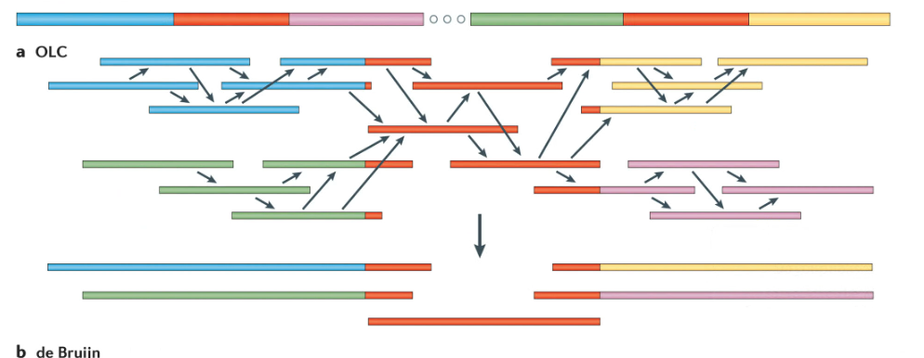
Overlap-Layout-Consensus
Overlap – compute overlaps between reads based on sequence alignments
Layout – assemble overlapping reads (greedy or string graph)
Consensus – generate contig sequences, by majority vote
Chaisson et al., (2015)

Slide 28
Overlap
An overlap is an alignment between a pair of reads
Can be Inverse
Or Forward

Slide 29
Recording an overlap
Choose the first read, it is always forward, it specifies the coordinate system
Record orientation
Record overhangs (A and B), read ends are coordinate starts
A-overhang(positive)
B-overhang (positive)
A-overhang(negative)
B-overhang (negative)
A-overhang(negative)
B-overhang (positive)
Contained overlap

Slide 30
Overlap is not an alignment
In there are indels, you can choose the longest stretch without them
Record R1, R2, orientation, A-hang, B-hang, overlap length or quality
AGATAGACATAGACATAGACAGATACAC ATAGACACAGACTATAGGCAGATACACTCGAT
AGATAGACATAGACATAGACAGATACAC ATAGACACAGACTATAGGCAGATACACTCGAT
R1(+): AGATAGACATAGACATAGACAGATACAC R2(-): ATAGACACAGACTATAGGCAGATACACTCGAT
Overlap:
R1 R2 – 1 5 27 or
R1 R2 – 2 5 26

